Slide 1
Improving the Parallel Execution of Behavior Trees
Michele Colledanchise
Lorenzo
Natale

Slide 2
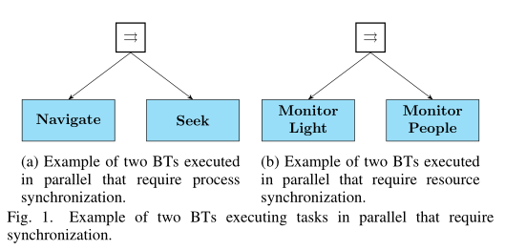
Motivation Example

Slide 3
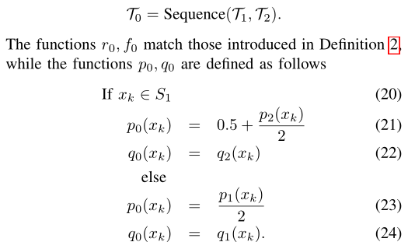
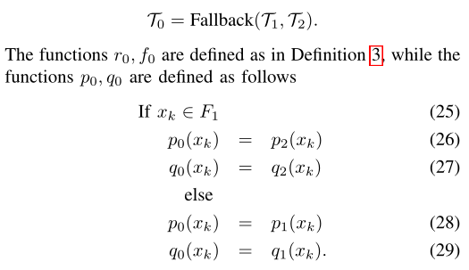
(Concurrent BTs): A CBT is a tuple
Ti = {fi, ri,∆t, pi, qi}
where i, fi,∆t, ri are defined as in Definition 1, pi is a progress function, and q is the resource function.
(Sequence compositions of CBTs):
(Fallback compositions of CBTs):

Slide 4
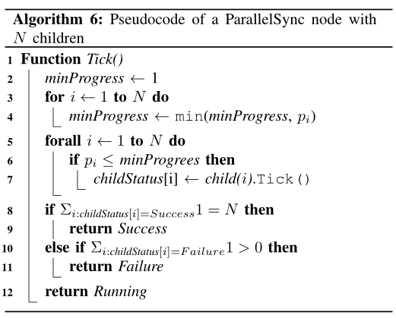
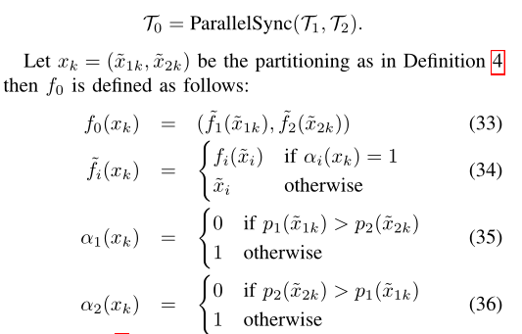
(Synchronized Parallel):

Slide 5
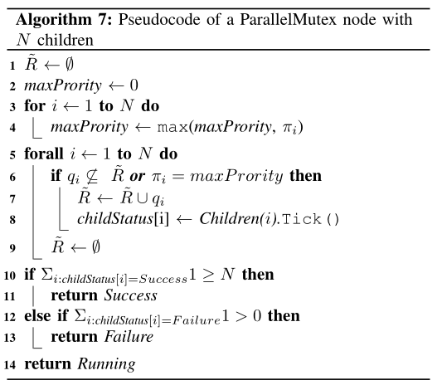
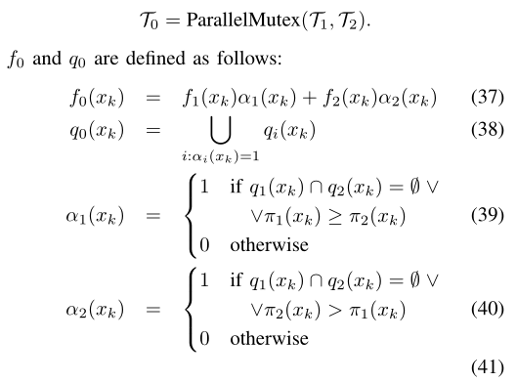
(Mutually Exclusive Parallel):

Slide 6
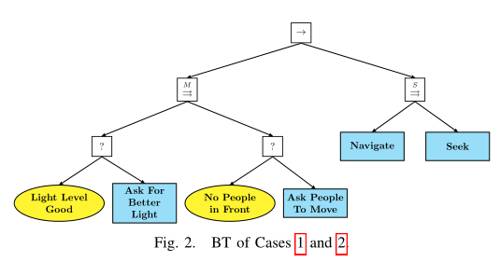
RobMoSys CARVE

